Slide 1
Customer Churn prediction and Tailored Email Messaging using GenAI
Pranavi Vasa

Slide 2
Content
Data
Exploratory Data Analysis
Metrics Chosen
Modeling
Results
Feature importance
Prompt for Email generation

Slide 3
Feature Engineering
Found missing values present in ToatalCharges. Imputed them with Median
Encoded target variable
Created new columns based on tenure.
Introduced new column based on services count.
Calculated spend ratio.

Slide 4
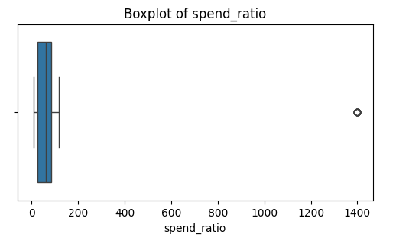
Outliers in Spend_ratio
Handled by capping the outliers

Slide 5
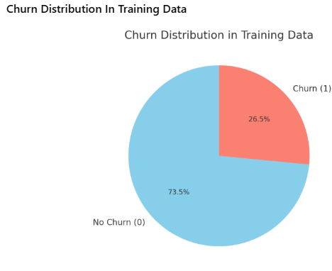
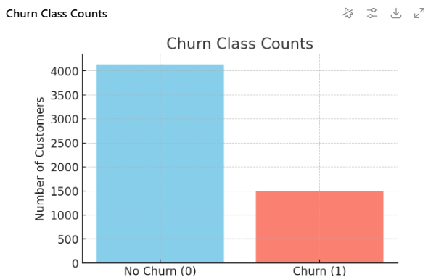
Class Imbalance

Slide 6
Metrics Chosen
Since business context matters more than generic accuracy, we used recall-heavy and business-aligned metrics:
F1 Score: Balances precision and recall. Useful for general churn identification where false positives and false negatives both matter.
F2 Score: Recall-weighted; chosen because the business priority is to catch churners early, even at the expense of some false alarms.
ROC-AUC: Measures ranking ability of the model; ensures good separation of churners vs. non-churners.
Precision@k (k=10%, 20%, 30%): Business interpretable metric — "If we target the top k% of customers most at risk, what fraction are actual churners?"
Recall@Precision ≥ 0.60: Ensures retention campaigns are not wasted on too many false positives while still capturing churners.

Slide 7
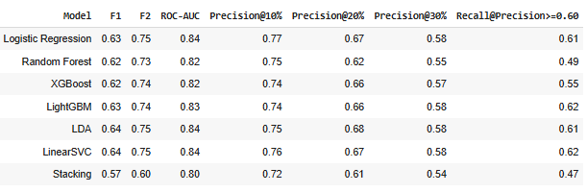
Different Models and metrics
Despite trying different models Logistic Regression was selected as the final model because it delivered the best balance of F1 and F2 scores, ensuring strong recall for churn detection while maintaining precision. It is simple, interpretable, robust on small datasets, and provides calibrated probabilities for business decision-making.

Slide 8
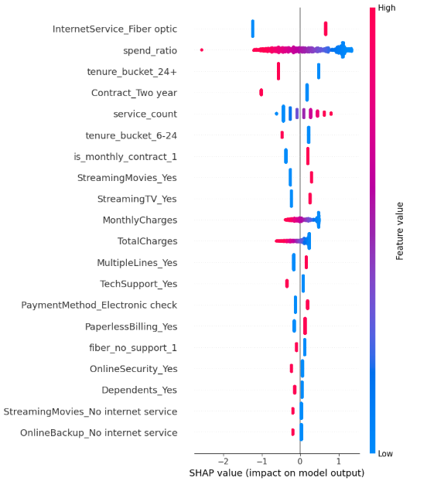
Feature Importance
churn is driven primarily by pricing pressure, lack of commitment, and absence of support/security services. Conversely, long-term relationships, multi-service bundles, and convenient payment methods reduce churn risk.
These insights can directly guide retention strategies, such as:
Offering contract upgrade incentives to month-to-month customers.
Providing discounts or loyalty rewards for high spend ratio customers.
Promoting bundled packages (multiple services + support).
Encouraging AutoPay enrollment to reduce churn risk.

Slide 9
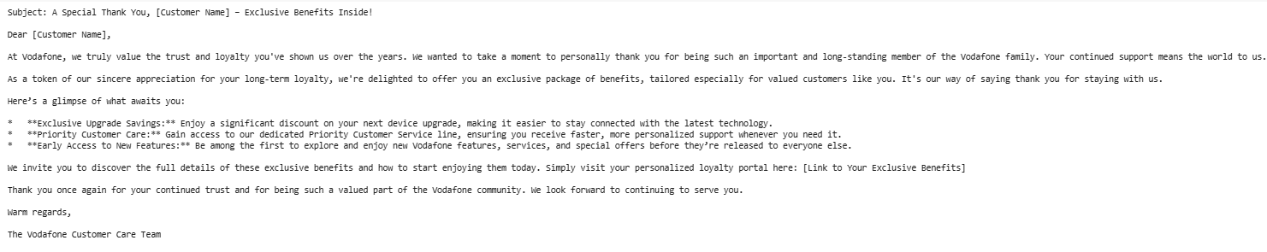
Sample Email Generated by Prompt

Slide 10
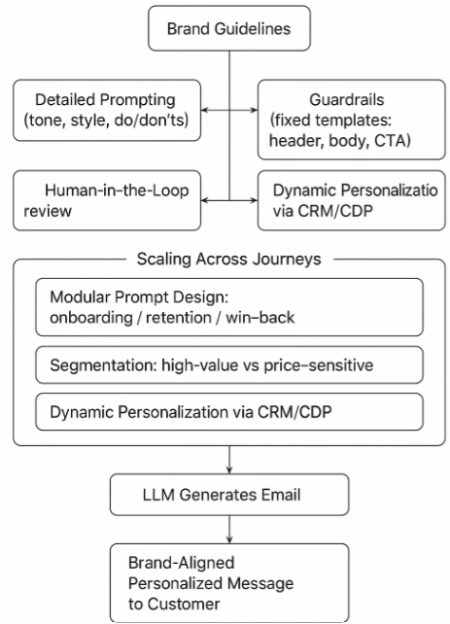
Brand Guidelines and Scaling

Slide 11
Conclusion
First, our Machine Learning model accurately predicts which customers are at risk of leaving. By analyzing key factors like contract type and tenure, we can identify and prioritize the customers who need our attention most.
Second, our Generative AI system creates personalized, on-brand emails for these at-risk customers. Using Large Language Models (LLMs) and a carefully designed prompt, we can scale our communication efforts while ensuring every message is tailored to the individual and aligned with our brand's voice.
This integrated approach shifts our strategy from reactive to proactive, allowing us to:
Boost Customer Satisfaction: By addressing customer needs before they become problems.
Increase Revenue: By retaining valuable customers.
Scale Our Efforts: By using AI to personalize communication at a massive scale.

Slide 12
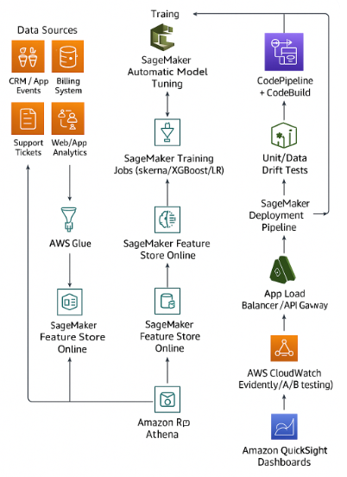
AWS ECO system Implementation of the solution

Slide 13


